Slide 1
INTRODUCTION
SOFTWARE ENGINEERING I

Slide 2
GRADING POLICY (TENTATIVE)
Every student has A as of today
Your future grade will be determined using the following criteria
Theory
10% Sectional-1
15% Sectional-2
50% Final
15% Assignments & Project
10% Quizzes

Slide 3


COURSE DETAILS
Books
  Somerville, Ian. Software Engineering, 9th Edition, Addison-Wesley, 2006
  R.S. Pressman, Software Engineering: A Practitioner's Approach, 6th ed., McGraw-Hill Book Co., NY, 2005
Policies
  Attendance policy
  Mobile phone usage
  Assignment submission
  Quizzes
  Fines
  Plagiarism policy
Important Rule – Don’t Cheat! (There will not be a 2nd warning)

Slide 4
LECTURE OUTCOMES
At the end of this lecture you should be able to answer the following key questions:
  What is software engineering?
  Why is software engineering important?
  What is the role of software in today’s age?

Slide 5
COURSE OUTLINE
Software Engineering I
This Semester
Software Engineering II
Next Semester
Evolving Role of Software
Software Process Models
Software Configuration management
Requirements Analysis
Use-Case Fundamentals
UML Notations
Actor-Goal Lists
Class Diagrams
Sequence Diagrams
Architecture
Architectural Patterns
Decision Tables
User Interface Design
Facts and Fallacies of Software Engineering
Requirements
Analysis and
Architecture
Design and Implementation

Slide 6
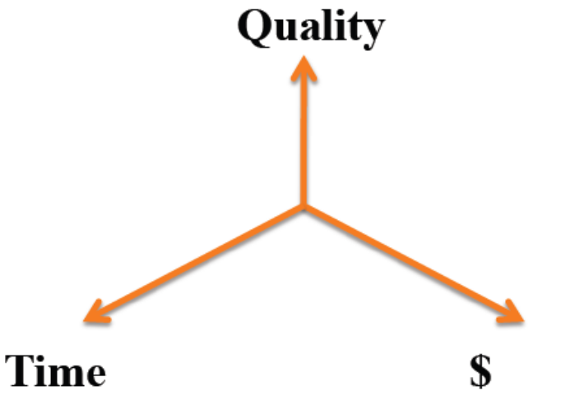
WHAT IS (NOT) S.E.?
Not just software programming
  Individual vs. team
Not just a process
  Field that studies several different processes
1-<number>

Slide 7
WHAT IS SOFTWARE ENGINEERING?
An Exercise: List all the ways in which
  Building a tinker-toy car for fun is different from designing a new automobile
  Building a tree-house is different from the architecture of a high-rise office building
So, how might software “engineering” be different from writing a 50-line Java applet?
SOFTWARE ENGINEERING - 2012

Slide 8
SOFTWARE VARIES
Size
How humans interact with it
Requirements stability/knowledge
Need for reliability
Need for security
Portability
Cost
1-<number>

Slide 9

MICROSOFT POWERPOINT
Size: large
Interactiveness: high
Requirements: frequent new features
Reliability: moderate
Security: low (at least used to be)
Portability: high
Cost: high
SOFTWARE ENGINEERING - 2011

Slide 10

SPACE SHUTTLE SOFTWARE
Size: moderate to large
Interactiveness: low
Requirements: stable
Reliability: very high
Security: low
Portability: low
Cost: high
1-<number>

Slide 11

ONLINE SHOPPING SOFTWARE
Size: moderate
Interactiveness: high
Requirements: frequent new features
Reliability: moderate
Security: high
Portability: low
Cost: low
1-<number>

Slide 12
YOUR EXAMPLE
Size:
Interactiveness:
Requirements:
Reliability:
Security:
Portability:
Cost:
1-<number>

Slide 13
WHY LEARN SOFTWARE ENGINEERING?
Not necessarily learning software engineering to engineer software.
By the end of this course, you will be trained on how to carry out a project successfully, how to communicate with the stakeholders & how to transform this communication into powerful models which will lead to a winning product.
Moreover you will also learn how to test these models & how to evaluate risks at every stage of the development process.

Slide 14
WHAT WILL YOU LEARN?
Understanding, clarifying and documenting the requirements for a customer
Planning how to conduct a project
Designing a software system at the architectural and detailed levels
Reviewing and testing designs and implementations

Slide 15
SOFTWARE ENGINEERING
What is Software?
  The programs, routines, and symbolic languages that control the functioning of the hardware and direct its operation.
  A set of instructions that cause a computer to perform one or more tasks. The set of instructions is often called a program

Slide 16
SOFTWARE ENGINEERING
What is Engineering?
  Engineering is the discipline and profession of applying technical, scientific and mathematical knowledge in order to utilize natural laws and physical resources to help design and implement materials, structures, machines, devices, systems, and processes that safely realize a desired objective.

Slide 17
SOFTWARE ENGINEERING
What is Software Engineering?
  Software engineering is the application of a systematic, disciplined, quantifiable approach to the development, operation, and maintenance of software.
  Software engineering encompasses a process, management techniques, technical methods, and the use of tools.

Slide 18
SOFTWARE PRODUCTS (TYPES)
Generic products
  Stand-alone systems that are marketed and sold to any customer who wishes to buy them.
  Examples – PC software such as graphics programs, project management tools; CAD software; software for specific markets such as appointments systems for dentists.
Customized products
  Software that is commissioned by a specific customer to meet their own needs.
  Examples – embedded control systems, air traffic control software, traffic monitoring systems.
CHAPTER 1 INTRODUCTION

Slide 19
FREQUENTLY ASKED QUESTIONS ABOUT SOFTWARE ENGINEERING
Question | Answer
What is software? | Computer programs and associated documentation. Software products may be developed for a particular customer or may be developed for a general market.
What are the attributes of good software? | Good software should deliver the required functionality and performance to the user and should be maintainable, dependable and usable.
What is software engineering? | Software engineering is an engineering discipline that is concerned with all aspects of software production.
What are the fundamental software engineering activities? | Software specification, software development, software validation and software evolution.
What is the difference between software engineering and computer science? | Computer science focuses on theory and fundamentals; software engineering is concerned with the practicalities of developing and delivering useful software.
What is the difference between software engineering and system engineering? | System engineering is concerned with all aspects of computer-based systems development including hardware, software and process engineering. Software engineering is part of this more general process.
CHAPTER 1 INTRODUCTION

Slide 20
FREQUENTLY ASKED QUESTIONS ABOUT SOFTWARE ENGINEERING
Question | Answer
What are the key challenges facing software engineering? | Coping with increasing diversity, demands for reduced delivery times and developing trustworthy software.
What are the costs of software engineering? | Roughly 60% of software costs are development costs, 40% are testing costs. For custom software, evolution costs often exceed development costs.
What are the best software engineering techniques and methods? | While all software projects have to be professionally managed and developed, different techniques are appropriate for different types of system. For example, games should always be developed using a series of prototypes whereas safety critical control systems require a complete and analyzable specification to be developed. You can’t, therefore, say that one method is better than another.
What differences has the web made to software engineering? | The web has led to the availability of software services and the possibility of developing highly distributed service-based systems. Web-based systems development has led to important advances in programming languages and software reuse.
CHAPTER 1 INTRODUCTION

Slide 21
ESSENTIAL ATTRIBUTES OF GOOD SOFTWARE
Product characteristic | Description
Maintainability | Software should be written in such a way so that it can evolve to meet the changing needs of customers. This is a critical attribute because software change is an inevitable requirement of a changing business environment.
Dependability and security | Software dependability includes a range of characteristics including reliability, security and safety. Dependable software should not cause physical or economic damage in the event of system failure. Malicious users should not be able to access or damage the system.
Efficiency | Software should not make wasteful use of system resources such as memory and processor cycles. Efficiency therefore includes responsiveness, processing time, memory utilisation, etc.
Acceptability | Software must be acceptable to the type of users for which it is designed. This means that it must be understandable, usable and compatible with other systems that they use.
CHAPTER 1 INTRODUCTION

Slide 22
QUESTIONS?

